Slide 1






2025 SPARK ACADEMY
TRAIN FOR CHANGE, FROM SCIENCE TO PRACTICE
THE SPRINT AI TRAINING FOR AFRICAN MEDICAL
Imaging Knowledge Translation (SPARK)
Academy
IN DEEP LEARNING & MEDICAL IMAGING
Introduction to SwinUNETR
April 19th, 2025

Slide 2
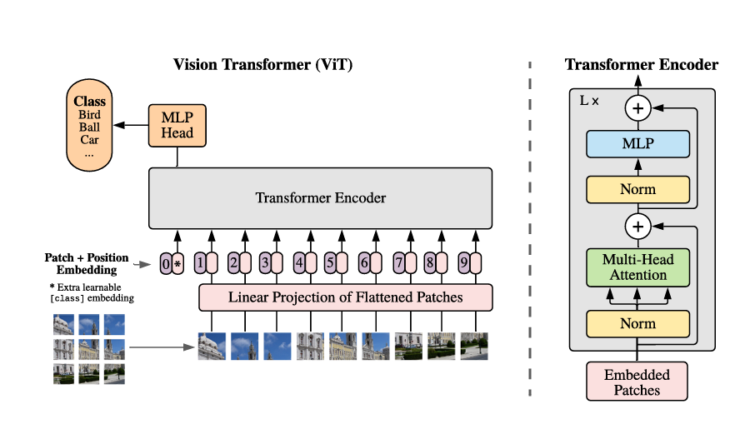
SwinUNETR
Borne of the Vision Transformer; an image is worth 16x16 words
https://arxiv.org/pdf/2010.11929
https://event.fourwaves.com/spark

Slide 3
SwinUNETR
Shifting Window Transformer
Swin UNEt TRansformers (Swin UNETR)
Limitations of Existing Methods and Motivation for Transformers
Limited kernel size restricts their ability to model long-range information.
This can lead to deficiencies in segmenting tumors with variable sizes.
https://event.fourwaves.com/spark

Slide 4
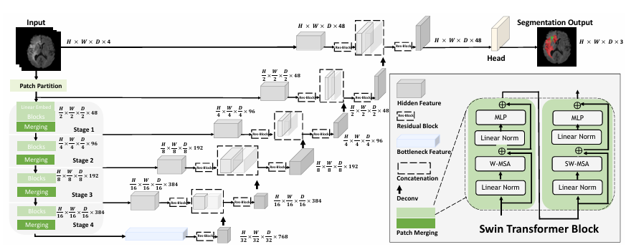
SwinUNETR
Swin UNEt TRansformers (Swin UNETR)
https://event.fourwaves.com/spark

Slide 5
SwinUNETR
Encoder (Transformer-based)
Decoder (Convolution-based)
https://event.fourwaves.com/spark

Slide 6
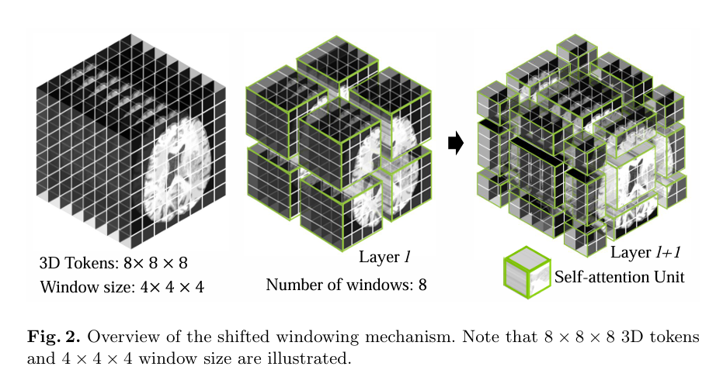
SwinUNETR
https://event.fourwaves.com/spark

Slide 7
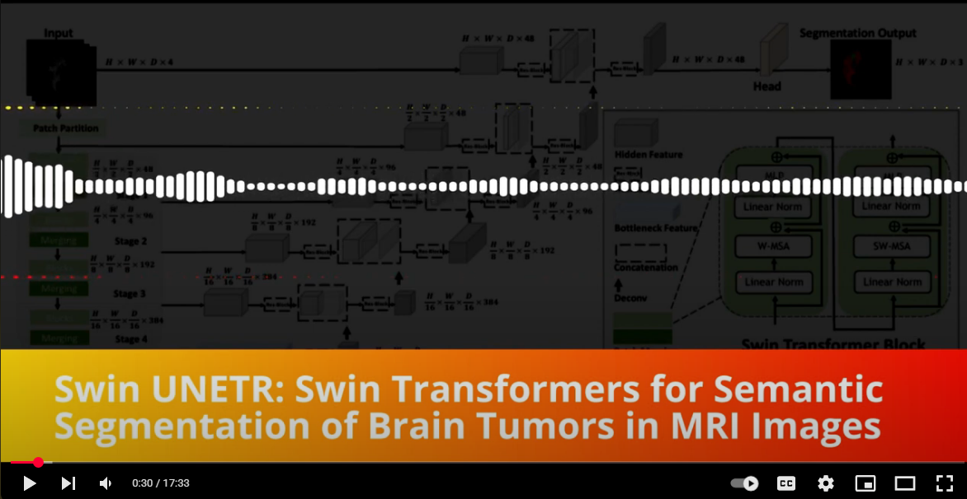
SwinUNETR
Swin Transformer Block
https://event.fourwaves.com/spark

Slide 8
SwinUNETR
SwinUNetR; Shifting Window Transformer for Semantic Segmentation of Brain Tumors
https://event.fourwaves.com/spark

Slide 9
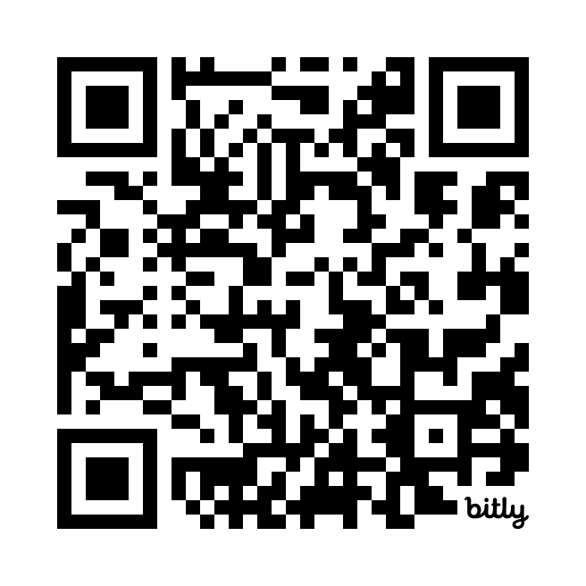
Get in touch?
Email
toufiqmusah32@gmail.com
Web
bit.ly/toufiqmusah

Slide 10
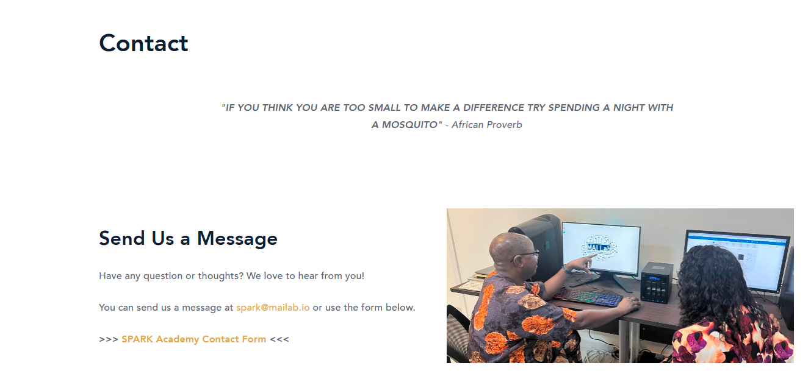
FAQ and Contact Information
Contact
For general program information, consult the FAQ section of the training platform in Fourwaves.
For general program inquiry, contact the SPARK Academy team at spark@mailab.io.
For project specific information or questions related to your team assignment, hackathon project or team’s BraTS project, contact your Team Supervisor.
For all other program related inquiries, contact the SPARK Academy team at spark@mailab.io
Socials: Follow us for up-to-date program information
https://twitter.com/CAMERAAfrica
https://twitter.com/mailab_io
https://www.linkedin.com/company/consortium-for-advancement-of-mri-education-research-in-africa
https://event.fourwaves.com/spark

